Slide 1
Subtyping and Inheritance
Prof. Dr. Dirk Riehle
Friedrich-Alexander University Erlangen-Nürnberg
ADAP C03
Licensed under CC BY 4.0 International
Notes:
It is Friedrich-Alexander University Erlangen-Nürnberg – FAU, in short.
Corporate identity wants us to say “Friedrich-Alexander University”.

Slide 2
Agenda
Forms of subtyping
Liskov Substitutability Principle (LSP)
Applied to class hierarchies
Co- and contravariance
Multiple inheritance
Abstract Superclass Rule (ASR)
Class hierarchy evolution
Cascading superclass calls

Slide 3
1. Forms of Subtyping

Slide 4
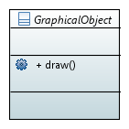
Subtyping Examples 1 / 3

Slide 5
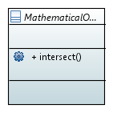
Subtyping Examples 2 / 3

Slide 6
Subtyping Examples 3 / 3

Slide 7
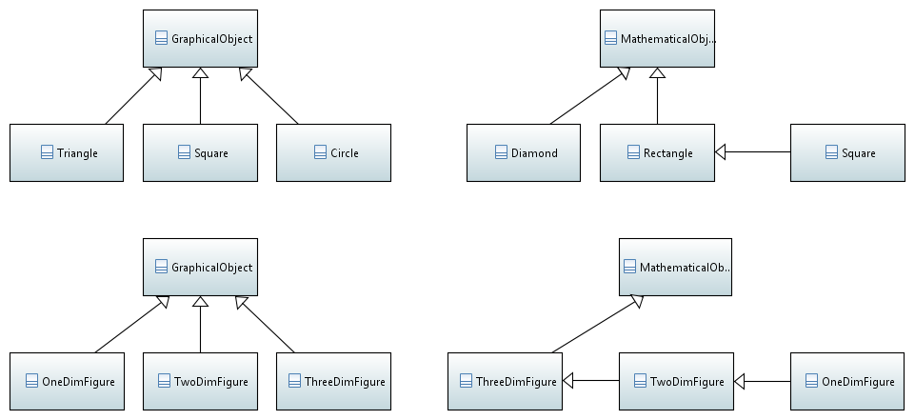
Subtyping Examples Discussion Continued

Slide 8
2. Liskov Substituability Principle

Slide 9
The Subtype Requirement [LW94] [1]
Let φ(x) be a property provable about objects x of type T. Then φ(y) should be provable for objects y of type S, where S is a subtype of T.
[1] A.k.a. Liskov Substitutability Principle (LSP)

Slide 10
In Simpler Words
All properties that hold for instances of a supertype should also hold for instances of a subtype.

Slide 11
Even Simpler
No surprises
for a use-client

Slide 12
3. Applied to Class Hierarchies

Slide 13
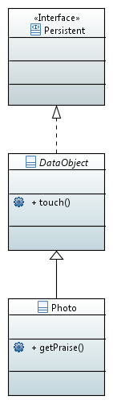
Subclasses as Extended Subtypes
Subclass
  Adds methods and state
  Does not constrain superclass
Example
  public void DataObject#touch()
  public float Photo#getPraise()

Slide 14
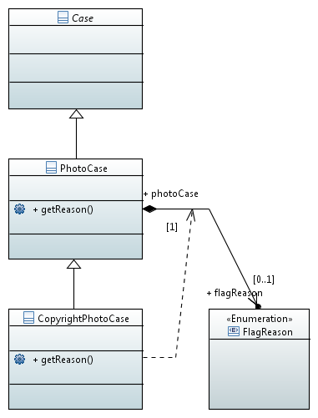
Subclasses as Constrained Subtypes
Constrained subtypes
  Superclass defines possibility space
  Subclass constrains behavior or return results
Example
  FlagReason PhotoCase#getReason()
    Returns any of enum FlagReason
  FlagReason CopyrightPhotoCase#getReason()
    Returns only FlagReason.COPYRIGHT

Slide 15
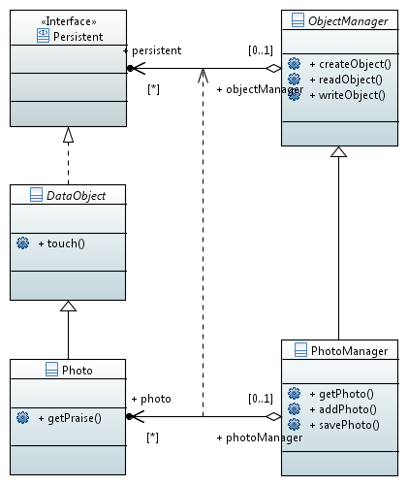
Dual Class Hierarchies
Constrained subtypes
  ObjectManager
  PhotoManager
Extended subtypes
  ObjectManager and DataObject
  PhotoManager and Photo
Association refinement

Slide 16
4. Co- and Contravariance

Slide 17
Covariance and Contravariance
Covariant redefinition
  A method has been covariantly redefined in its result or argument types if those result or argument types are of a subclass of the original result or argument types
Contravariant redefinition
  A method of a has been contravariantly redefined in its result or argument types if those result or argument types are of a superclass of the original result or argument types

Slide 18
Quiz: Co- and Contravariance
Which form of redefinition of result types violates the Liskov Substituability Principle, if any?
  Contravariant redefinition
  Covariant redefinition
  None
  Both
Which form of redefinition of method argument types violates the Liskov Substituability Principle, if any?
  Contravariant redefinition
  Covariant redefinition
  None
  Both

Slide 19
Covariance of Method Result Types
General Java examples
  Object Object#clone()
  MyClass MyClass#clone()
Wahlzeit examples
  Persistent ObjectManager#createObject(...)
  Photo PhotoManager#createObject(...)
Covariant redefinition of method result types satisfies the LSP
  Case of the constrained subtypes

Slide 20
Contravariance of Method Argument Types
Not a language feature in Java (but in other languages)
  Hence no examples at hand
Contravariant redefinition of method arguments satisfies the LSP
  Case of the extended subtypes

Slide 21
5. Multiple Inheritance

Slide 22
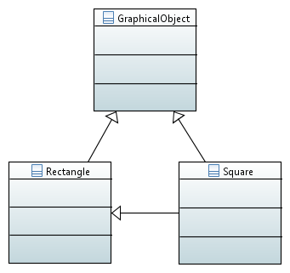
Multiple Inheritance
{private}
Not possible in Java (not a language feature)

Slide 23
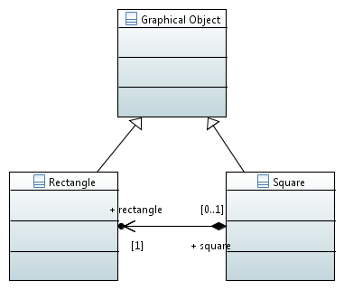
Implementation Delegation
Well possible in Java (and other languages)

Slide 24
Interface vs. Implementation Inheritance
Interface inheritance
  Follows the LSP
  Can be realized in Java
    Using Java interfaces
    Using regular classes
Implementation inheritance
  Breaks the LSP
  Can be realized in Java
    But is generally a bad idea
    Rather use delegation

Slide 25
6. Abstract Superclass Rule

Slide 26
Inheritance and Abstractness
Inheritance
  Relationship between two classes, a superclass and a subclass
Abstract(ness)
  Relationship between a class and its instances (none if abstract)

Slide 27
Abstract Superclass Rule (ASR) [H94]
All superclasses must be abstract
(in design).

Slide 28
Abstract Superclass Rule as a Guideline
A superclass should be abstract in implementation.

Slide 29
How to Make a Class Abstract (in Java)
By declaration
  of the class, e.g. “abstract class Counter { … }”
  of at least one method, e.g. “public abstract void count(...)”
By hiding constructors
  by declaring them protected or private
  by making sure no implicit public empty constructor exists
By inheritance
  by inheriting from an abstract class and
  not completing it
The best way is to explicitly declare one’s intention

Slide 30
Corollaries to Abstract Superclass Rule
Hard corollaries (rules)
  No abstract class should subclass a concrete class
  All subclasses should first be abstract, then concrete
Soft corollaries (guidelines)
  The root of a class hierarchy should be an abstract class
  (Most) leaf classes in an application should be concrete
In a framework, leaf classes may be abstract
  Because they are expecting subclasses in applications

Slide 31
But Why? LSP applied to ASR
The ASR helps comply with the LSP
  The ASR automatically casts subclasses as constrained subtypes
    Applying the ASR, developers have to think about subclasses
    Subclasses fill in the holes defined by the abstract superclass
    Thus, concrete subclasses constrain the abstract superclass
    With this, the abstract superclass becomes better (re)usable

Slide 32
7. Class Hierarchy Evolution

Slide 33
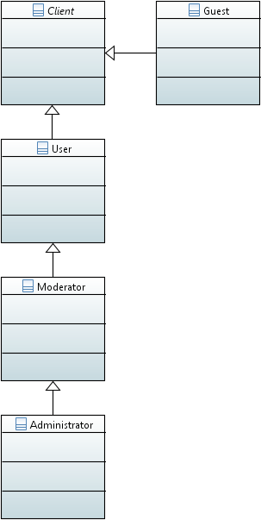
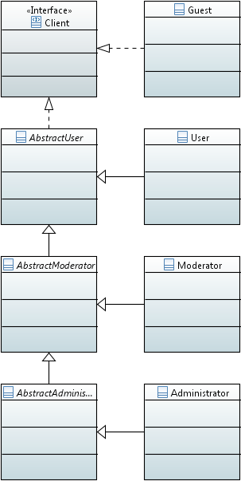
Transforming a Class Hierarchy
To transform a class hierarchy to conform to the ASR, split the instantiable superclass into an abstract class and introduce an instantiable subclass that completes the new abstract superclass.

Slide 34
Simplifying a Class Hierarchy
To simplify a class hierarchy, merge a default implementation with its abstract superclass.

Slide 35
What to Use When?
Transform to conform in preparation for
  Increasingly complex default implementation class
  Other implementation classes as alternatives
Simplify (and not conform) to
  Reduce number of overall classes
  Assuming implementation class is basically empty

Slide 36
8. Cascading Superclass Class

Slide 37
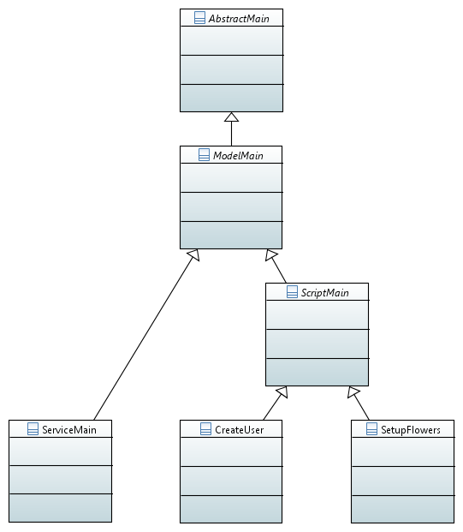
Cascading Inheritance Interfaces
ServiceMain#startUp() →
  ModelMain#startUp() →
    AbstractMain#startUp()
ServiceMain#shutDown() →
  Modelmain#shutDown() →
    AbstractMain#shutDown()
CreateUser#execute() →
ScriptMain#execute()

Slide 38
Cascading Superclass Calls
public void ServiceMain#startUp(boolean ip, String rd) ... {
super.startUp(ip, rd);
log.info("ModelMain#startUp() completed");
log.config(LogBuilder.createSystemMessage()...);
initWebPartTemplateService();
...
protected void ModelMain#startUp(boolean ip, String rd) ... {
super.startUp(ip);
log.info("AbstractMain#startUp() completed");
log.config(LogBuilder.createSystemMessage()...);
initImageStore();
...
protected void AbstractMain#startUp(boolean ip) throws Exception {
isInProduction = ip;
}

Slide 39
Traditional Run vs. ServletContext
public static main(String[] argv) { new FlowersMain.run() }
void FlowersMain#run() {
...
startUp();
execute();
shutDown();
...
}
public void contextInitialized(ServletContextEvent sce) {
...
serviceMain.startUp(true, rootDir);
...
}
public void contextDestroyed(ServletContextEvent sce) {
...
serviceMain.shutDown();
...
}

Slide 40
Summary
Forms of subtyping
Liskov Substitutability Principle (LSP)
Applied to class hierarchies
Co- and contravariance
Multiple inheritance
Abstract Superclass Rule (ASR)
Class hierarchy evolution
Cascading superclass calls

Slide 41
Thank you! Questions?
dirk.riehle@fau.de – https://oss.cs.fau.de
dirk@riehle.org – https://dirkriehle.com – @dirkriehle
DR

Slide 42
Legal Notices
License
  Licensed under the CC BY 4.0 International License
Copyright
  © 2012-2022 Dirk Riehle, some rights reserved

